Slide 1

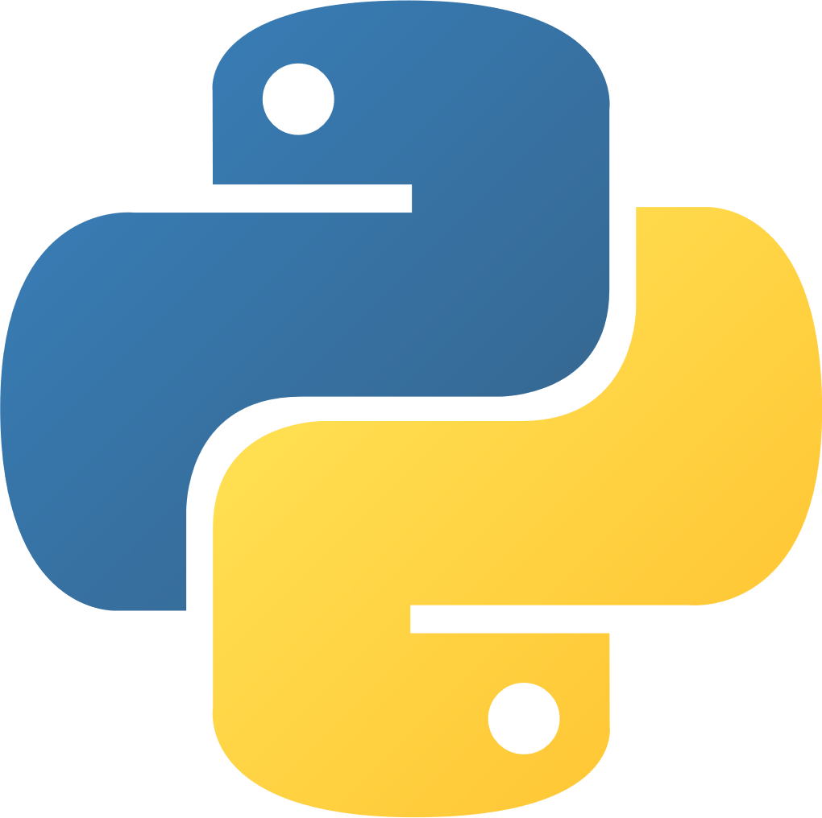
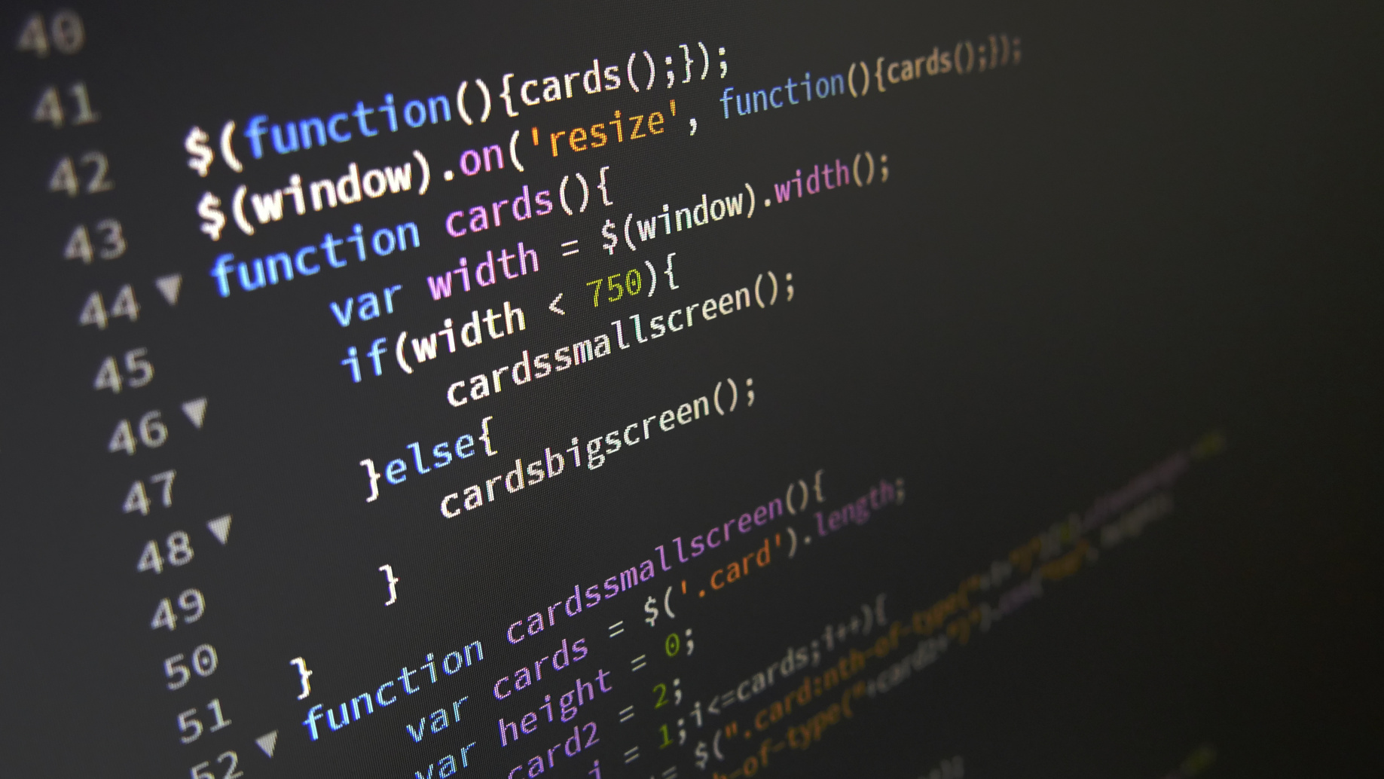
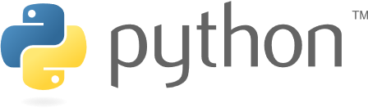
Topic: PYTHON PROGRAMMING
Presented by: RITAM MONDAL
python intern at Vault of Codes
(Assignment 1, task 2)
Date: 7th June 2025

Slide 2
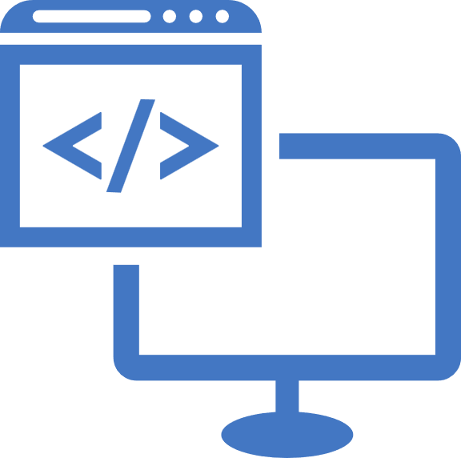
Introduction to Python
Python is a high-level, interpreted programming language.
Known for its readability and simplicity.
Widely used in web development, data science, AI, machine learning, automation, etc.
Supports object-oriented programming (OOP) principles.
Open-source and community-supported.

Slide 3

History of Python
Python was created by Guido van Rossum in the late 1980s.
Officially released in 1991.
Named after the British comedy group "Monty Python".
Major versions:
1. Python 2.0 (2000): in 2000 introduced major feature
2.Python 3.0 (2008): (Py3k) released in 2008 with modern syntax
Constantly evolving with regular updates.

Slide 4

Key Features of Python
Easy-to-learn syntax
Interpreted language (no compilation needed)
Dynamically typed
Large standard library
Extensible with other languages like C/C++

Slide 5
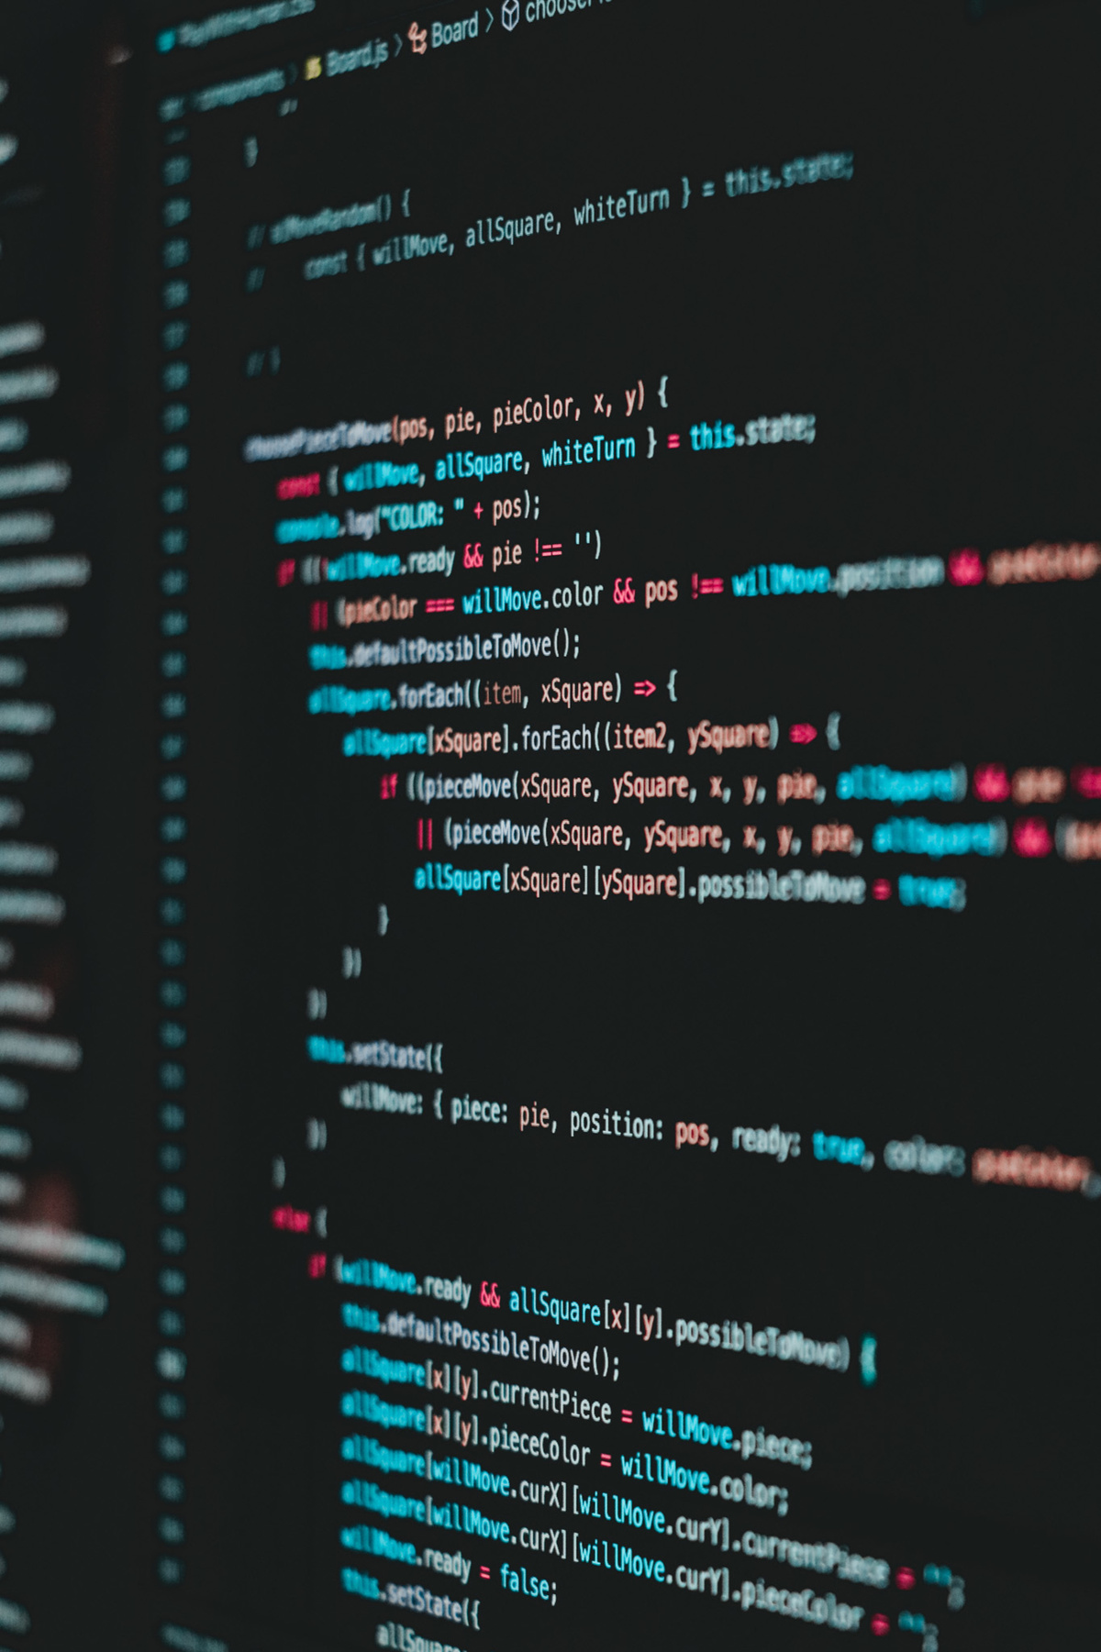
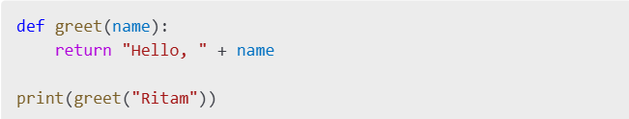
Functions in Python
Definition: Created with def keyword followed by name and parameters.
Parameters: Placeholders for values passed to functions.
Arguments: Actual values passed to functions.
A block of reusable code that performs a specific task.
Helps in breaking code into smaller, manageable parts.
Exampe
Output: “Hello, Ritam”

Slide 6
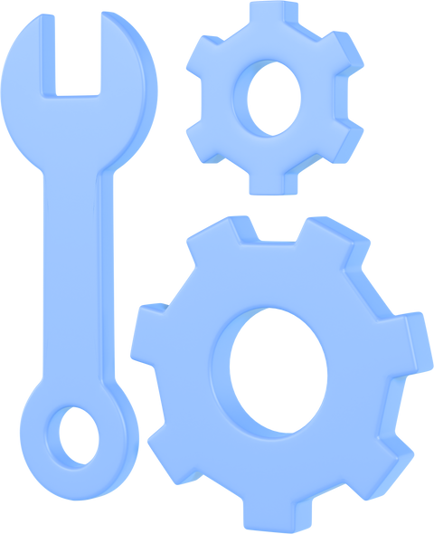
Types of Functions
Built-in Functions: print(), len(), range() etc.
User-defined Functions: Created by the user using def keyword.
Lambda Functions: Anonymous, one-liner function
Function Arguments: Positional, keyword, default, variable-length.
Function Overloading: Achieved through default and variable-length arguments.

Slide 7
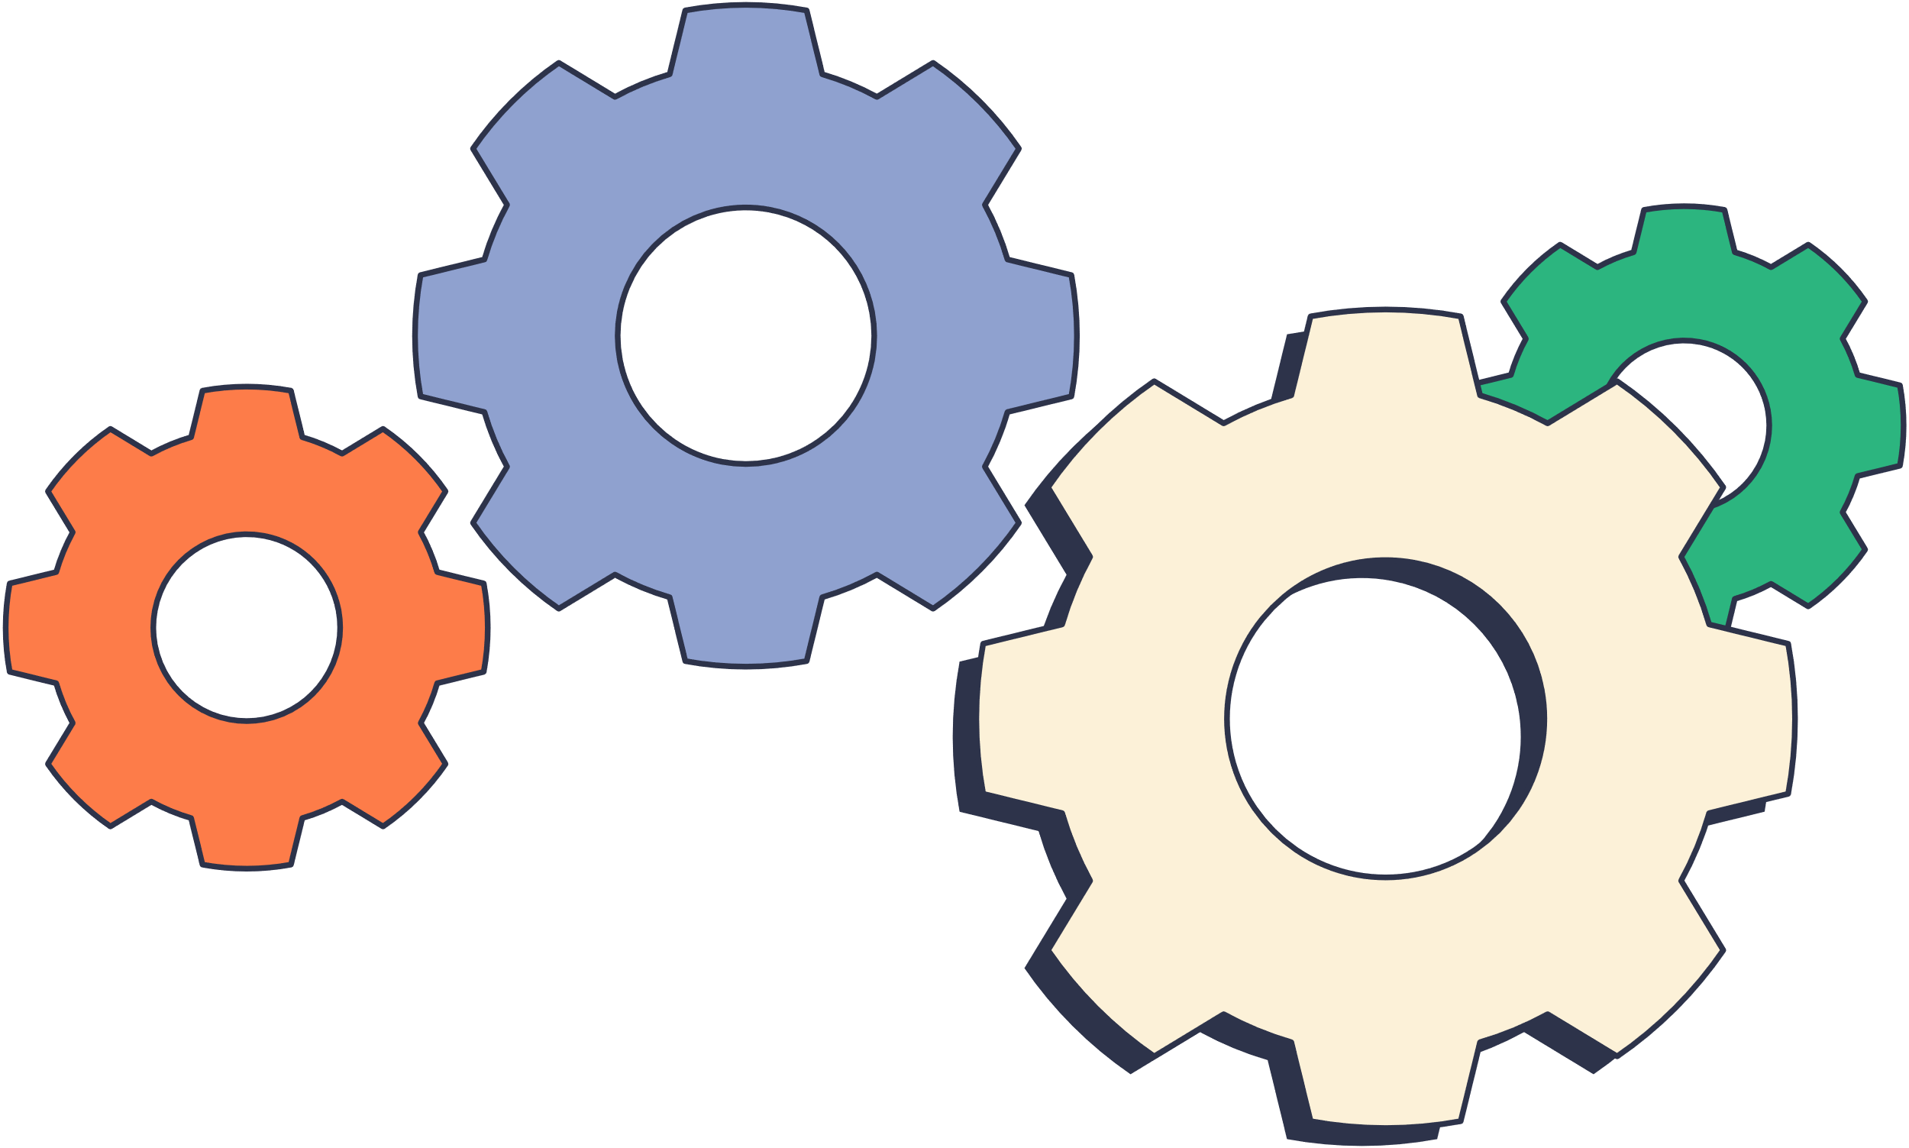
Modules in Python
A module is a file containing Python code (functions, variables, classes).
Purpose: Organize code into reusable and manageable units
Promotes code reuse and modular programming.
Third-Party Modules: External modules available via package managers (pip).
Can import built-in or custom modules.
Creating Modules: Write your own modules for custom functionality.
Usage: Access module contents using dot notation (module.function()).

Slide 8

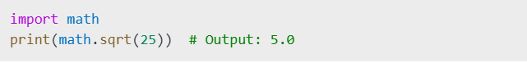
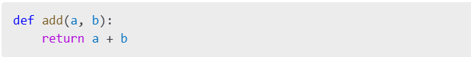
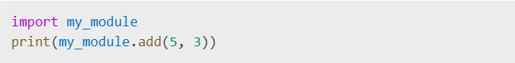
Importing Modules
Use import keyword to access functions/objects from another file/module.
Can also use from module import function.
Creating Your Own Module
my_module.py
main.py

Slide 9

Conclusion
Python is a beginner-friendly language with powerful features.
Functions help break down code and reuse logic.
Modules organize and structure large codebases.
Mastering these concepts forms the foundation of Python programming.
Reference
Python Programming
history of python
Geeks of geeks, history of python

Slide 10


